Slide 1

Unlocking the World of Web Development
Welcome to this presentation on web development! In today's digital world, the internet is an integral part of our lives, and web development plays a crucial role in shaping our online experiences. We will explore the essential building blocks of web development, delve into the key technologies involved, and uncover the exciting career opportunities that await.
sk
by seif eddine krimi

Slide 2
The Foundation: Understanding Web Development
Web development is the process of creating and maintaining websites. It encompasses everything from designing the look and feel of a website to coding the functionality that makes it interactive. Web development is essential for businesses, organizations, and individuals to connect with their audience online.
Content
Functionality
Web developers create the content that users see on a website, including text, images, videos, and audio. They use HTML, CSS, and JavaScript to structure, style, and make the content interactive.
Web developers also create the functionality that makes a website work, including forms, buttons, and menus. They use JavaScript to add interactivity and create dynamic user experiences.

Slide 3
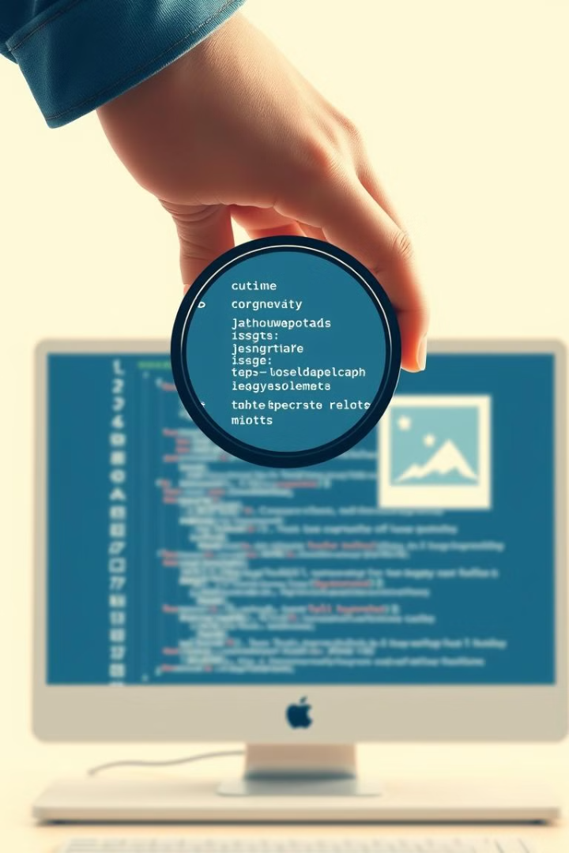
The Language of the Web: HTML
HTML, which stands for HyperText Markup Language, is the foundation of all websites. It's like the blueprint that defines the structure and content of a webpage. It uses tags to create headings, paragraphs, lists, and images, structuring the information displayed to the user.
1
Structure
2
Content
HTML provides the structure for a webpage, defining the different sections and elements of content.
HTML defines the content of a webpage, including text, images, and other media.
3
Accessibility
HTML enables websites to be accessible to everyone, regardless of their abilities or disabilities.

Slide 4




Styling the Web: CSS
CSS, or Cascading Style Sheets, is used to style the visual appearance of a website. It's like the makeup that transforms the raw structure of a webpage into an aesthetically pleasing design. CSS allows web developers to control the color, font, size, and layout of elements on a webpage.
Colors
Fonts
Layout
CSS defines the colors of text, backgrounds, and other elements on a webpage.
CSS determines the font style, size, and weight of text on a webpage.
CSS controls the position, size, and spacing of elements on a webpage.

Slide 5

Bringing Websites to Life: JavaScript
JavaScript is a powerful scripting language used to add interactivity and dynamic features to websites. It's like the magic that makes websites come alive. JavaScript allows developers to create animations, respond to user actions, and make websites more engaging and responsive.
Interactivity
Animations
JavaScript allows developers to create interactive elements like buttons, forms, and menus that respond to user actions.
JavaScript allows developers to create animations and special effects that make websites more engaging and visually appealing.
Data Handling
JavaScript can be used to manipulate data on a webpage, making it more dynamic and user-friendly.

Slide 6

Building User Interfaces: React
React is a popular JavaScript library for building user interfaces. It's like a toolkit for crafting complex and interactive website components. React allows developers to create reusable UI components that can be easily integrated into different parts of a website. This modular approach makes web development faster and more efficient.
1
Components
React allows developers to break down user interfaces into reusable components, making development faster and more efficient.
2
Virtual DOM
React uses a virtual DOM to optimize performance by updating only the necessary parts of the user interface.
3
State Management
React provides tools for managing the state of UI components, making it easier to build dynamic and responsive interfaces.

Slide 7




The Power of Node.js
Node.js is a powerful JavaScript runtime environment that allows developers to build server-side applications. It's like the engine that powers a website behind the scenes. Node.js provides a framework for handling requests from users, processing data, and responding to them, creating a seamless user experience.
Server-Side
Node.js enables developers to create server-side applications that handle requests from users and process data.
Scalability
Node.js is known for its scalability, making it suitable for applications that need to handle a large number of users.
Real-Time
Node.js excels at building real-time applications, such as chat applications, online games, and collaborative tools.

Slide 8

Web Development: Your Gateway to Tech
Learning web development can open doors to a fulfilling career in the tech industry. It is a valuable skillset that is in high demand across various industries. Web development allows you to create dynamic and responsive websites, ensuring a seamless user experience.
1
Career Growth
The tech industry is booming, and web developers are in high demand, offering a promising career path.
2
Creative Control
You can bring your ideas to life and build engaging and interactive online experiences.
3
Global Impact
Web development allows you to create solutions that reach a global audience and make a positive impact.

